Slide 1
Smart Stock Dashboard: Real-Time Tracking and Future Price Prediction
S Sarvesh – 23BRS1380
R Rithvik Nimal – 23BRS1377
Shuruthi Ajay – 23BRS1338

Slide 2
Introduction
Purpose: This project is a stock dashboard that shows live stock prices and predicts future prices.
Importance: Accurate stock predictions help investors make better financial choices.
Main Features: The dashboard tracks live stock prices, shows price changes, and predicts future stock values.
Technology: It uses Flask for the app, yFinance for stock data, and an LSTM model for predictions.
User-Friendly: The dashboard is easy to use, letting users track stocks and see predictions in one place.

Slide 3


Technology Stack
Front-End
Back-End

Slide 4
Data Collection
Data Source: We use the yFinance API to collect historical and real-time stock data directly from Yahoo Finance.
Data Type: The main data includes stock prices and volume, focusing on closing prices for predictions.
Time Frame: For model training, data is collected from 2012 to the present to capture long-term trends.
Update Frequency: Real-time data updates every 25 seconds on the dashboard, keeping the information current.
Data Preprocessing: Collected data is scaled (using MinMaxScaler) to fit within a range, which improves the accuracy of predictions.

Slide 5
Model Architecture
Model Type: The model is an LSTM (Long Short-Term Memory) neural network, which is effective for time-series data like stock prices.
Input Shape: The model takes sequences of stock prices over a 60-day period, allowing it to learn from recent trends.
Layers and Units: The model has three LSTM layers, each with 60 units, capturing complex patterns in stock price movements.
Dropout Layers: Dropout layers are added after each LSTM layer to prevent overfitting, improving the model's generalization to new data.
Output Layer: The final layer is a dense layer with one unit, which predicts the stock price for the next day based on learned trends.

Slide 6
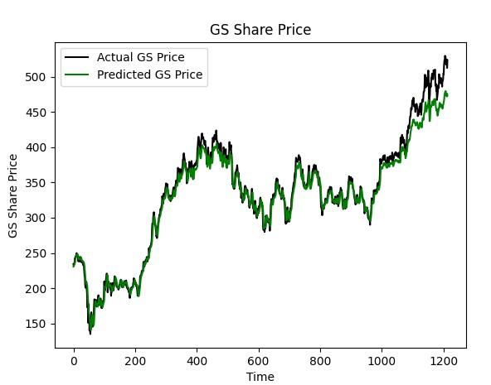
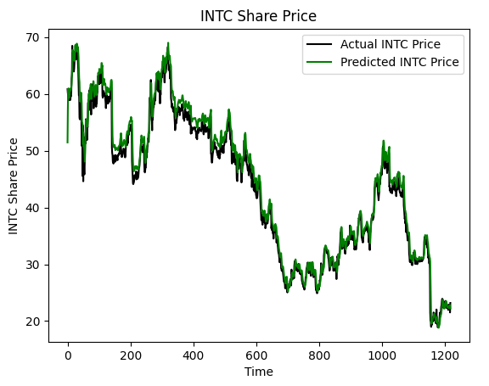
Model Accuracy

Slide 7
Dashboard Workflow
User Input: Users can enter stock ticker symbols (e.g., AAPL, TSLA) to add stocks they want to track.
Real-Time Data Fetching: The dashboard fetches the latest stock prices from the yFinance API, updating every 25 seconds to display current prices and percentage changes.
Price Display: Each stock’s price and daily percentage change are displayed in a table, providing a quick overview of current performance.
Prediction Request: Users can click the "Predict" button next to a stock to generate a forecasted price. The app then sends the ticker symbol to the prediction API endpoint.
Prediction Display: The predicted stock price is returned and displayed alongside the real-time data, allowing users to view both the current and predicted values for better insights.

Slide 8
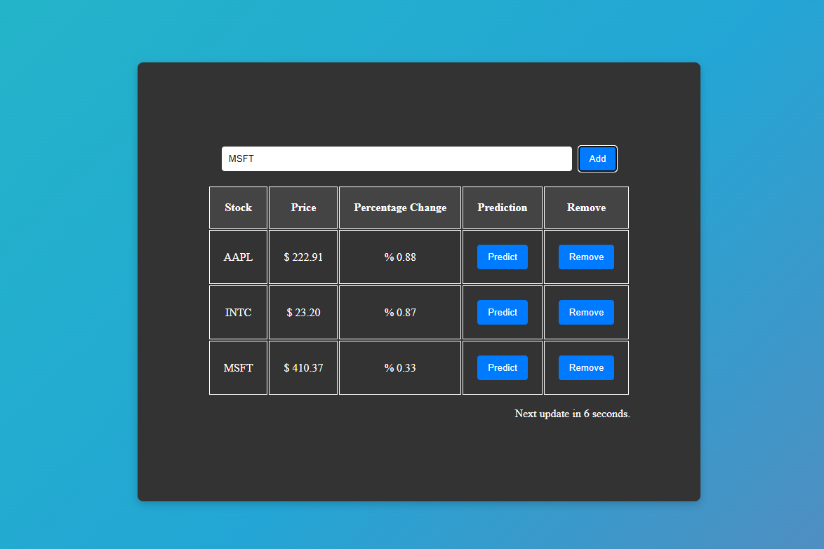
Dashboard UI

Slide 9
Conclusion
Summary of Accomplishments: The dashboard successfully combines real-time stock tracking with predictive insights, providing a valuable tool for investors.
User Impact: It offers a simple and interactive way for users to monitor stocks and anticipate potential price trends.
Learning Outcome: This project demonstrates how machine learning models, specifically LSTMs, can be integrated with live data to generate meaningful predictions.

Slide 10
Future Scope
Enhanced Model Accuracy: Future versions could use additional data, such as financial news or trading volume, to improve prediction accuracy.
Expanded Data Sources: Adding data from multiple sources or APIs could provide broader and more reliable data for both tracking and predictions.
Additional Metrics: Implementing more financial indicators, such as moving averages or RSI, would give users deeper insights.
User Alerts: Adding alert features to notify users when a stock price reaches certain thresholds or deviates significantly from predictions.

Slide 11
THANK YOU

